Slide 1
Scheduling Project Group 13
Team Members:
Anisha
Daniel
Nawaf
Stanley

Slide 2
Introduction
This project is being developed to help UMKC schedule creators create schedules that do not violate professor constraints. This system is secure, intuitive, and easy for schedule creators to make schedules without technical backgrounds.

Slide 3
Database tab
In order to use the schedule creating function, you must populate the database with professors, constraints, courses, and rooms. This is easily done through the database tab which you can navigate to by clicking “Database” located on the navbar at the top of the screen
This screen shows three collapsible tables that display objects related to schedule creation
Object creation, editing, and deletion are easily accessible when the table for that object is expanded. Each page has the necessary information for creating the object

Slide 4
Database tab – Collapsible tables

Slide 5
Database tab – Crud Functionality

Slide 6
Annealing scheduling (generating algorithm)
We used Simulated Annealing to generate multiple schedules and ultimately find the most optimal one.
We retrieve data from the database and translated into constraints for the algorithm.
Algorithm is highly dependent on constraints, as well as the temperature.
User will be warned before generating a schedule to check on the constraints before clicking the button.

Slide 7
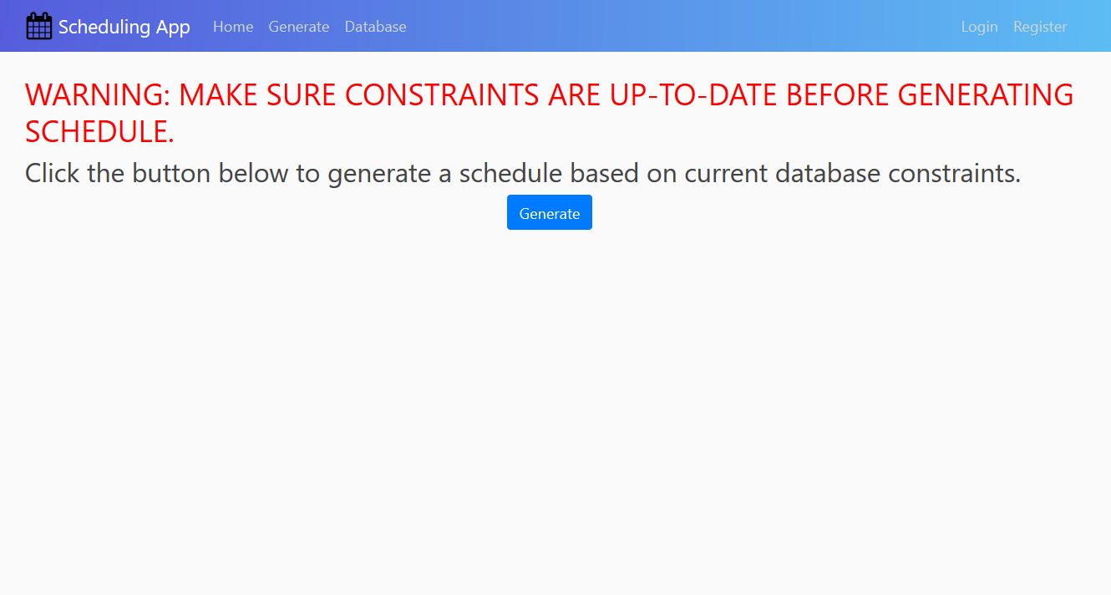

Slide 8
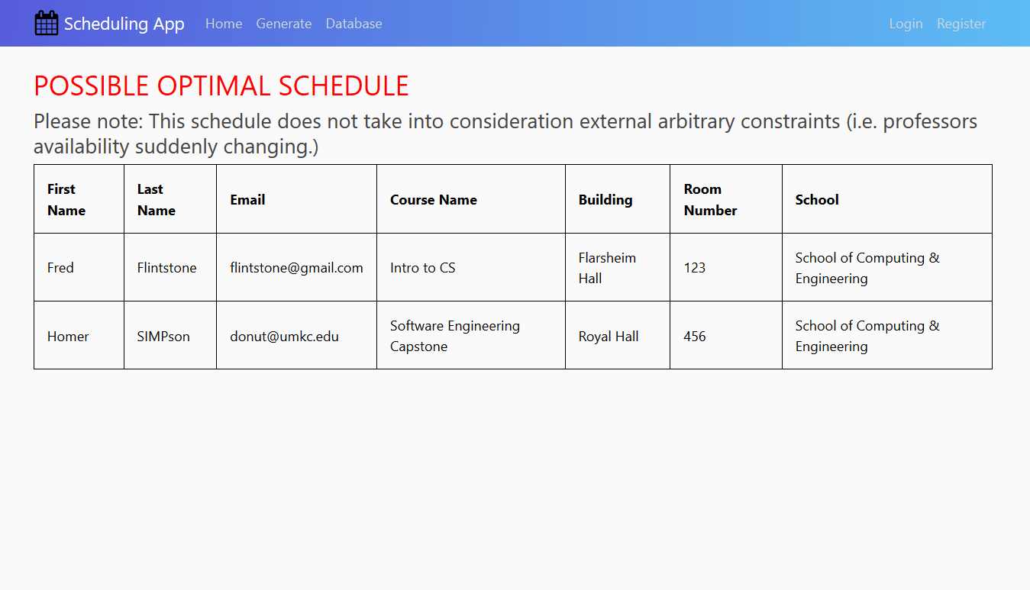

Slide 9
Terminology
System – Tracking the professor and student’s availability along with classrooms within UMKC SCE database
User – Professors and students will login to the scheduling system, type of user will be specified
Site- the front-end website (main page) using web mail
Username/Password- unique identifiers that authenticate and validates a user

Slide 10
terminology
Login - the act of logging in to a computer, database, or system
Authentication - the process or action of verifying the identity of a user
Active Directory (AD) – System that will allow users to authenticate to UMKC network
Connection – Link between devices on a network

Slide 11
constraints
The project must be a web application since UMKC issued computers prevent users from installing programs. The final product must also not rely on third party licensed software.
Users do not come from a technical background and will have to be able to interface with software easily.

Slide 12
scope
At the minimum, the software will allow users to create constraints with varying priorities for individual professors and allow the user to place professors and classes into a schedule and determine if any constraint is violated. The scope can be extended to generating the best-fit schedule with least amount of constraints violated.

Slide 13
Risks and obstacles to success
Due to COVID-19, it impacted our classes, projects, personal lives (family issues, job hardship), have to travel back to home countries which results in improper distribution of the workload and experimenting with an unknown form of development led to some of our project’s vision go unfulfilled.
The team does not have a lot of experience with git and Django python web interface. Lack of experience cause under and overestimates for complexity and time on features we plan to implement.

Slide 14
Success Criteria
The project will be a success if by the end of the semester, users can generate decent schedules that violate the least amount of constraints and can use them to plan the next semesters schedule effectively applicable from May 15, 2020.

